Slide 1
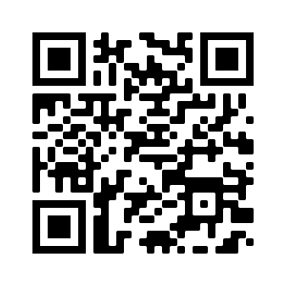
WELCOME!
For attendance credit, sign in with QR Code or link beside the QR Code
https://ky.readyop.com/fs/4osq/893976b5

Slide 2
MINUTES APPROVAL for
May 11, 2023 Meeting
REQUIRES VOTE
The following corrections to the Communications section of the minutes have been made:
The Alvaton Fire Station Winlink tower was damaged due to storms. Status on when the tower will be repaired is unknown at this time. Winlink is currently operable.
Discussion/Corrections? - Motion – Second
Zoom Voters: Put the following in the chat
Minutes
Agency/Your name
Yes/No or With Revisions

Slide 3
HEART Coalition EPI Report
Notes:
** All data presented is for situational awareness and is not to be shared with the general public.

Slide 4
Region 4 COVID-19 Numbers
County | Cases | Deaths
Allen | 8,675 | 127
Barren | 17,782 | 258
Butler | 4,855 | 61
Edmonson | 3,371 | 61
Hart | 7,073 | 112
Logan | 10,580 | 145
Metcalfe | 3,825 | 80
Monroe | 4,572 | 94
Simpson | 7,714 | 112
Warren | 56,339 | 444
Total: | 124,409 | 1,479
Notes:
This data is from KDPH COVID dashboard.
We saw the largest increase of case in the month of December.
**This table and numbers below are showing COVID deaths as they are being counted instead of when they occurred.
May to June
+377 cases
+15 deaths
April to May
+815 case
+17 deaths
March to April
+984 case
+34 deaths
February to March
+1,720 cases
+8 deaths
January to February
+2,487 cases
+21 deaths
December to January:
+ 3,281 cases
+ 18 deaths
November to December:
+2,011 cases
+ 13 deaths

Slide 5
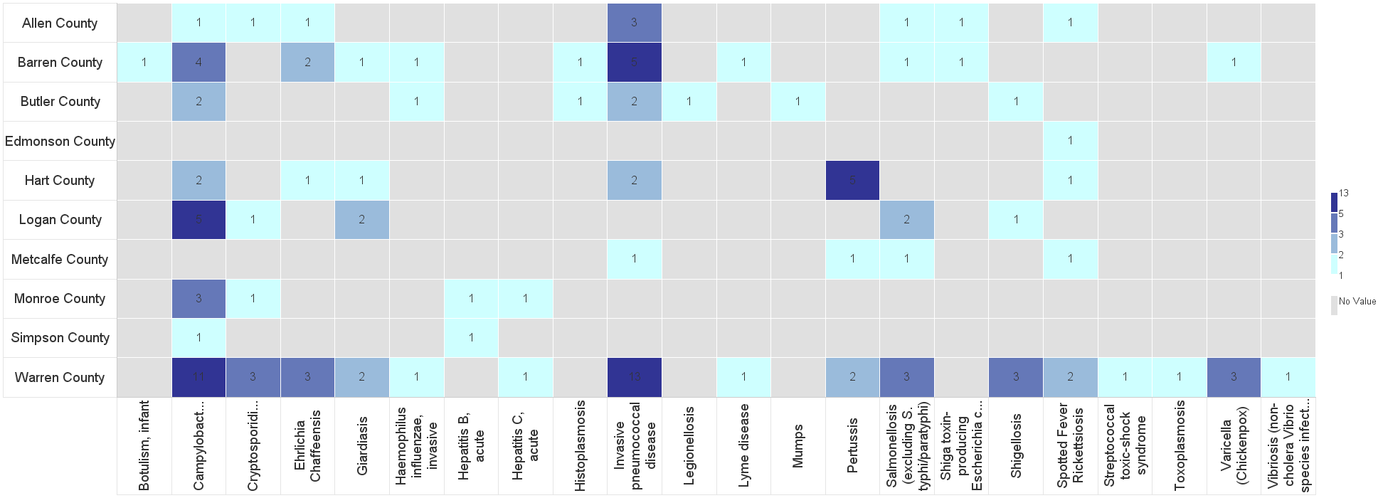
Barren River Reportable Disease 2023 Year to Date
Notes:
2023: 124 cases confirmed/probable/suspect as of 6/7/2023. This time last year, there were about 103 cases investigated.
**Numbers are not finalized and are subject to change.

Slide 6
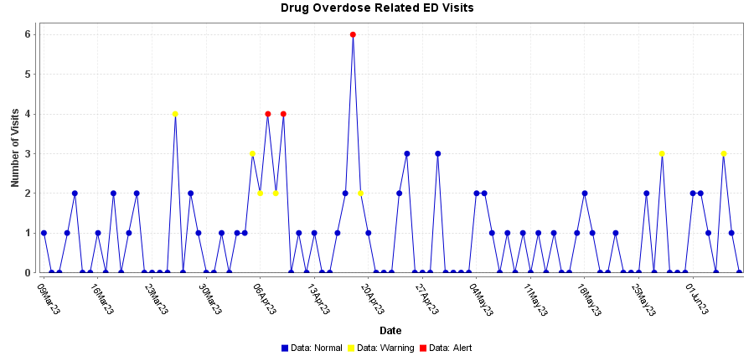
Syndromic Data: Drug Overdose
Notes:
Overdose Related ED Visits: Fentanyl, Heroin, Opioid
* These are patients who were seen at hospitals in the Barren River Region. Bases on Chief Complaint and Discharge Diagnosis coding.

Slide 7
Contact
Regional Epi: Kristen Eggles
Kristen.Eggles@ky.gov
Ext. 262
District Epi: India Martinez
India.Martinez@barrenriverhealth.org
Ext. 105

Slide 8
TOUGH TALKS STEPHEN PARROTT

Slide 9
COMMITTEE UPDATES
Long Term Care
Communications
Training & Exercise
Use this QR Code to sign in. Be sure to list ALL agencies you represent!
https://ky.readyop.com/fs/4osq/893976b5

Slide 10
Purchase Requests
EvacuB Baby Stair Evacuation - $8,000 for 2 units with O2 splitter
“This is a T.E.S.T” Radiation game $64.26 ea, 4 games = 257.04, not including shipping
Ham Radio Books/Class for 10 ea. Books are current through 2026 - $700
17 ft Bumper Pull Refrigerated Trailer (16 decedents) - $63,050
Diesel generator (Kubota GL7000) with integrated transfer switch, $7,500
Spare HD Aluminum racks with wall-mount ratchet straps (4 trays – increasing capacity to 24 decedents) - $1,500
Cadaver Lift – 1000 lb - $2,190
Shipping and Handling - $3,500

Slide 11
MACH 5 - 5 Minutes to Preparedness
It is obvious from the preliminary damage assessments coming in that EOC operations will need to be sustained for at least a few weeks. In order to sustain operations, the EOC Director is going to close down some non-essential services. The EOC Director wants to know how many people you can drum up from your department who work in non-essential functions. These non-essential persons may be used to augment EOC operations.
- What services in your department are considered “essential” and will need to continue regardless of EOC operations?
- How many people in the non-essential services might be re-assigned to emergency functions, and what can they contribute? (i.e. record keeping, information gathering, assisting the public in other departments, helping out in a shelter, etc.)
Keep responses to 25 to 30 seconds.

Slide 12
Miscellaneous/Questions
Unmet Needs?
Identified Gaps?
Use this QR Code to sign in. Be sure to list ALL agencies you represent!

Slide 13
Meeting Changes!
September 14 meeting is Zoom ONLY
December 7 Meeting – 1st Thursday of month

Slide 14
Next Meeting
Thursday, July 13, 2023
11:30am Lunch available/Networking
12:00pm Meeting time
Use this QR Code to sign in. Be sure to list ALL agencies you represent!

