Slide 1
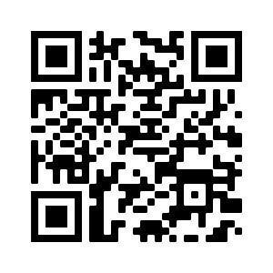

https://ky.readyop.com/fs/4osq/893976b5
WELCOME!
Carley Beatty, Intern from Murray State
Member Updates
September 14 Minutes Approval – REQUIRES VOTE
EPI Report
1, 1.1, 1.2

Slide 2
HEART Coalition EPI Report
Notes:
** All data presented is for situational awareness and is not to be shared with the general public.

Slide 3
Region 4 COVID-19 Numbers
County | Cases | Deaths
Allen | 9,083 | 128
Barren | 18,625 | 259
Butler | 4,995 | 63
Edmonson | 3,484 | 61
Hart | 7,304 | 112
Logan | 10,931 | 148
Metcalfe | 4,062 | 82
Monroe | 4,780 | 94
Simpson | 8,070 | 114
Warren | 59,140 | 456
Total: | 130,474 | 1,517
Notes:
This data is from KDPH COVID dashboard.
**This table and numbers below are showing COVID deaths as they are being counted instead of when they occurred.
Sept to Oct.
+ 1,811 cases
+ 4 deaths
August to September
+ 2885 cases
+ 7 deaths
July to August
+ 703 cases
+ 9 deaths
June to July
+ 666 cases
+ 18 deaths
May to June
+377 cases
+15 deaths
April to May
+815 case
+17 deaths
March to April
+984 case
+34 deaths
February to March
+1,720 cases
+8 deaths
January to February
+2,487 cases
+21 deaths
December to January:
+ 3,281 cases
+ 18 deaths
November to December:
+2,011 cases
+ 13 deaths

Slide 4
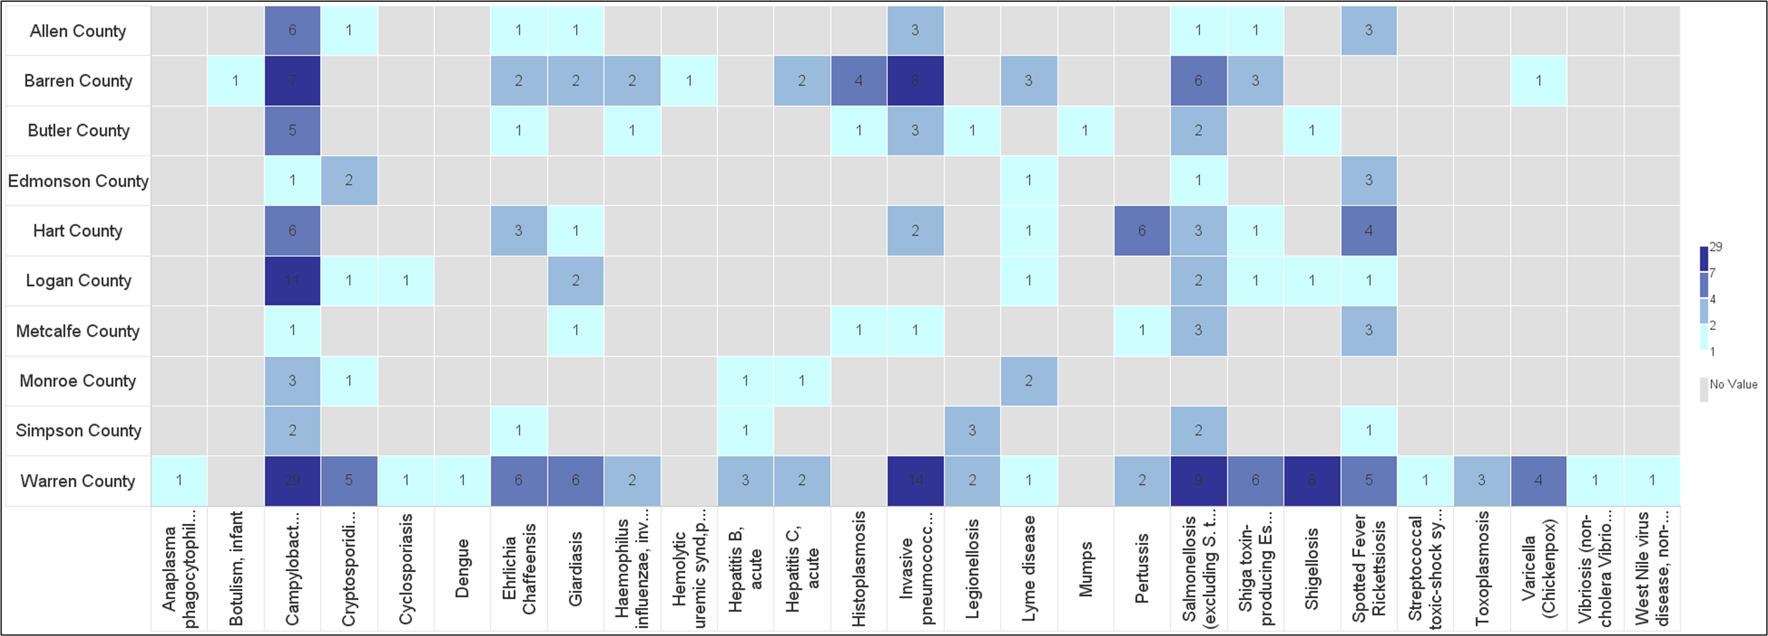
Barren River Reportable Disease 2023 Year to Date
Notes:
2023: 273 cases year-to-date, increased by 25 since last meeting.
Highest burden: Campy (71), IPD (31), and Salmonella (29). Enteric diseases are the highest burden followed by tickborne diseases.
**Numbers are not finalized and are subject to change.

Slide 5
Contact
Regional Epi: Kristen Eggles
Kristen.Eggles@ky.gov
Ext. 262
District Epi: India Martinez
India.Martinez@barrenriverhealth.org
Ext. 105

Slide 6
emPOWER Data and Social Vulnerability Index
HHS empower Map https://empowerprogram.hhs.gov/empowermap
  Updated monthly with de-identified data for Medicare beneficiaries
  Includes
    Electricity-dependent DME and devices data
    At-Risk Combination Data of electricity-dependent DME and devices, and essential health care services
    Severe weather and natural hazards data
    Geographic information system (GIS) base maps
  Weather and natural hazard data updated hourly or daily
  Job Aid/Intro to HHS emPOWER map: https://empowerprogram.hhs.gov/Map-Job-Aid.pdf

Slide 7
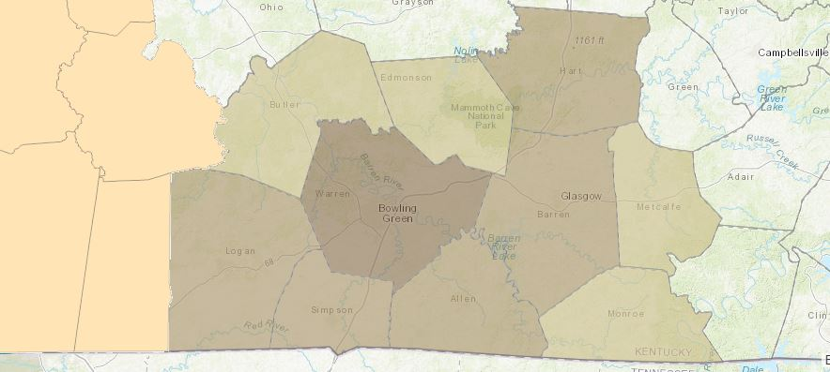
Medicare Data At-Risk Beneficiaries for HEART Region
Geography | Beneficiaries | At-Risk Beneficiaries
Allen | 4521 | 337
Barren | 9949 | 840
Butler | 2628 | 207
Edmonson | 2031 | 187
Hart | 4082 | 319
Logan | 6710 | 372
Metcalfe | 2756 | 236
Monroe | 2762 | 206
Simpson | 4102 | 312
Warren | 23765 | 1342

Slide 8
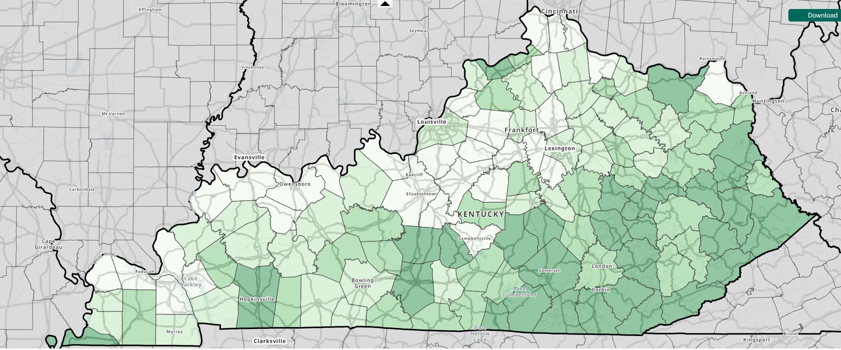
CDC/STSDR Social Vulnerability Index (SVI)
Helps estimate amount of needed supplies (food, water, medicine, etc)
Helps estimate number of emergency personnel required to assist people
Identify areas in need of emergency shelters
Plan best way to evacuate people, account for those with special needs
Identify communities that will need extra funding and support before, during, and after disaster
https://www.atsdr.cdc.gov/placeandhealth/svi/interactive_map.html

Slide 9
Subcommittee Reports
  Budget/Finance Update
Received:
  Toner
  EvacuB
  WifiCase
New Request: REQUIRES VOTE
  Shelving
  Wrap for Morgue Trailer
  Message Board “wrap”

Slide 10
Subcommittee Reports
  Long Term Care – Greg Manley
  Communications: Robert Doughty
  Medical Reserve Corp (MRC) – Carolyn Bishop
  Training & Exercise – Yvette Coleman

Slide 11
Important Dates!
October 24: Senior Officials All Hazards Workshop
November 1: Community Planning for Disaster Recovery
November 15: Winter Weather Hazards: Science and Preparedness
November 15: LTC Education Day 2023 (Madisonville)
December 13-14: Disaster Preparedness for Healthcare Organizations within Community Infrastructure
Save the Date: Jan 11- This is a T.E.S.T Radiation Simulation TTX during Coalition meeting
Save the Date: January 25 – Rural Trauma Team Development Course/Burn
March 19-20: Medical Management of CBRNE Events

Slide 12
Comments/Unmet Needs
National Incident Management System (NIMS) Resource Management Survey: https://preptoolkit.fema.gov/web/nims-toolkit/nims-survey
  By providing input, stakeholders can inform future updates to the NIMS processes, resources, and tools they use daily
Hamas leader, Khalid Mashal, reportedly calling for global Jihad to target the people of Israel on Friday, Oct. 13.

Slide 13
About half of the EOC/DOC staff lives more than 40 miles from the EOC/DOC. Normally their commute times very between one hour and one- and one-half hour. Because of all the highway damage, they are now looking at commute times in excess of 2 to 3 hours each way. A twelve-hour workday, plus four to six hours of commute time will begin to take its toll.
What can be done to ensure these essential employees don’t burn out in one or two days?

Slide 14

Thursday, November 9, 2023
9:30 am Medical Reserve Corp
10:30 am Long Term Care
11:30am Networking Lunch
12:00pm HCC Meeting time
Use this QR Code to sign in. Be sure to list ALL agencies you represent!

