Slide 1
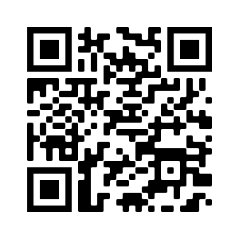
PLEASE SIGN IN WITH QR CODE

Slide 2
Voting eligibility standards per By-laws
4.2.c. Representation: Persons representing more than one agency or organization will be allowed to represent both agencies for the purposes of calculating attendance. Individuals shall be connected (employed, volunteer, board member) with the agency/agencies that they are representing and shall note the agency on the sign-in- sheet or in the chat when attending virtually. Individuals shall cast one vote for one agency, regardless of the number of agencies they represent during regular meetings.
4.2.g. Quorum: A quorum (which is defined as a simple majority) of the active coalition members present in-person or via ZOOM.
4.4.c. New Members, as defined in paragraph 4.1.e, must attend three (3) consecutive meetings. Voting rights begin upon attendance at the fourth consecutive meeting.
4.4.b. For a member agency or organization to have voting rights, a representative from that agency or organization must have attended 75% of the previous scheduled monthly meetings during the past 11 months. Canceled meetings and special called meetings will not be considered a regularly scheduled meeting. An attendance log will be sent out via email monthly. It is noted that certain votes may carry additional requirements that must be abided by.

Slide 3
WELCOME!
MINUTES APPROVAL for December 8, 2022 Meeting
REQUIRES VOTE
Discussion/Corrections? - Motion – Second
Vote – You MUST list the agency you are voting for! You may represent more than one agency for attendance, but ONLY vote as a representative for ONE agency.
Use this QR Code to vote. Be sure to vote your primary agency ONLY!

Slide 4
HEART Coalition EPI Report
Notes:
** All data presented is for situational awareness and is not to be shared with the general public.

Slide 5
Region 4 COVID-19 Numbers
County | Cases | Deaths
Allen | 8,280 | 124
Barren | 16,555 | 237
Butler | 4,620 | 56
Edmonson | 3,202 | 54
Hart | 6,720 | 109
Logan | 10,090 | 137
Metcalfe | 3,598 | 76
Monroe | 4,404 | 89
Simpson | 7,258 | 103
Warren | 53,490 | 414
Total: | 118,217 | 1,399
Notes:
This data is from KDPH COVID dashboard.
December to January:
+ 3,281 case
+ 18 deaths
November to December:
+2,011 cases
+ 13 deaths

Slide 6
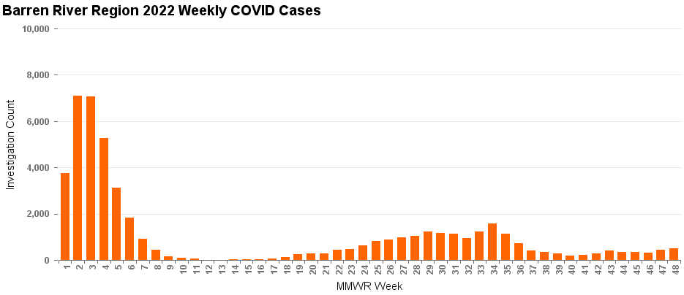
2022 Weekly COVID-19 Cases
Notes:
This graph is from Business Objects. Numbers are not final.
643 mmwr 1
81 mmwr 2

Slide 7
Influenza
Notes:
**2020-2021 data may not be representative of true numbers of cases due to COVID-19.
There are been 11 flu related deaths in the Region.

Slide 8
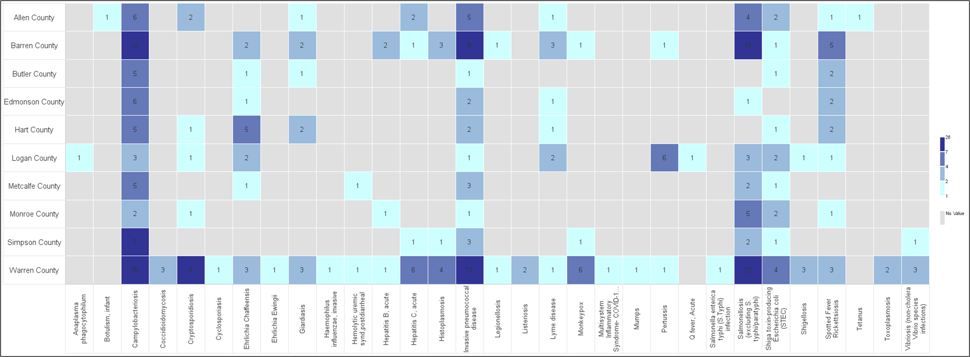
Barren River Reportable Disease 2022 Year to Date
Notes:
323 total reportable disease that have a completed/approved notification as of 10/31/2022. The darker the color, the more cases.
Other Reportable Disease News:
Uganda Ministries Declare Ebola Outbreak Over- Jan 11
**this data is not final

Slide 9
Contact
Regional Epi: Kristen Eggles
Kristen.Eggles@ky.gov
Ext. 262
District Epi: India Martinez
India.Martinez@barrenriverhealth.org
Ext. 105

Slide 10
COMMITTEE UPDATES
Long Term Care – Greg Manley
Communications – Robert Doughty
Budget – Yvette Coleman
Training & Exercise
Use this QR Code to sign in. Be sure to list ALL agencies you represent!

Slide 11
Budget FY22-23
Trauma Symposium (October) Allocated $12,000, used $6425.46, $5,574.54 available
Executive Breakfast – Food, Venue $2,500 (work plan) REQUIRES VOTE
PortaCount Calibration & Cleaning Contract (3-year contract) $6,430(work plan) REQUIRES VOTE
2-day TEEX training Pediatric Disaster Response & Emergency Preparedness Course (capability gap) - $800 REQUIRES VOTE

Slide 12
L1301: Continuity Planning Course Frankfort, KY – Jan 18-19, 2023
Seats Available!
IMPORTANT: IS-1300 Introduction to Continuity of Operations is a an online prerequisite course. Please be sure you have completed this course prior to registering for the L1301 Continuity Planning Course described above.
To register for the course you will need to take a couple of steps, first:
Take IS-1300, Introduction to Continuity of Operations. This course is one hour long, and it is the prerequisite.
Get a FEMA Student Identification (SID) number at https://cdp.dhs.gov/femasid/register if you do not have one already.
​​​​​​​Once you have completed the perquisite and have a SID, go to https://training.fema.gov/netc_online_admissions/ and click on NETC Online Admissions Application. As you work through the registration screens, remember your class number is L1301: Continuity Planning (For State Level ESF Partners Agencies/Kentucky Commonwealth) and the date of delivery is January 18-19.

Slide 13
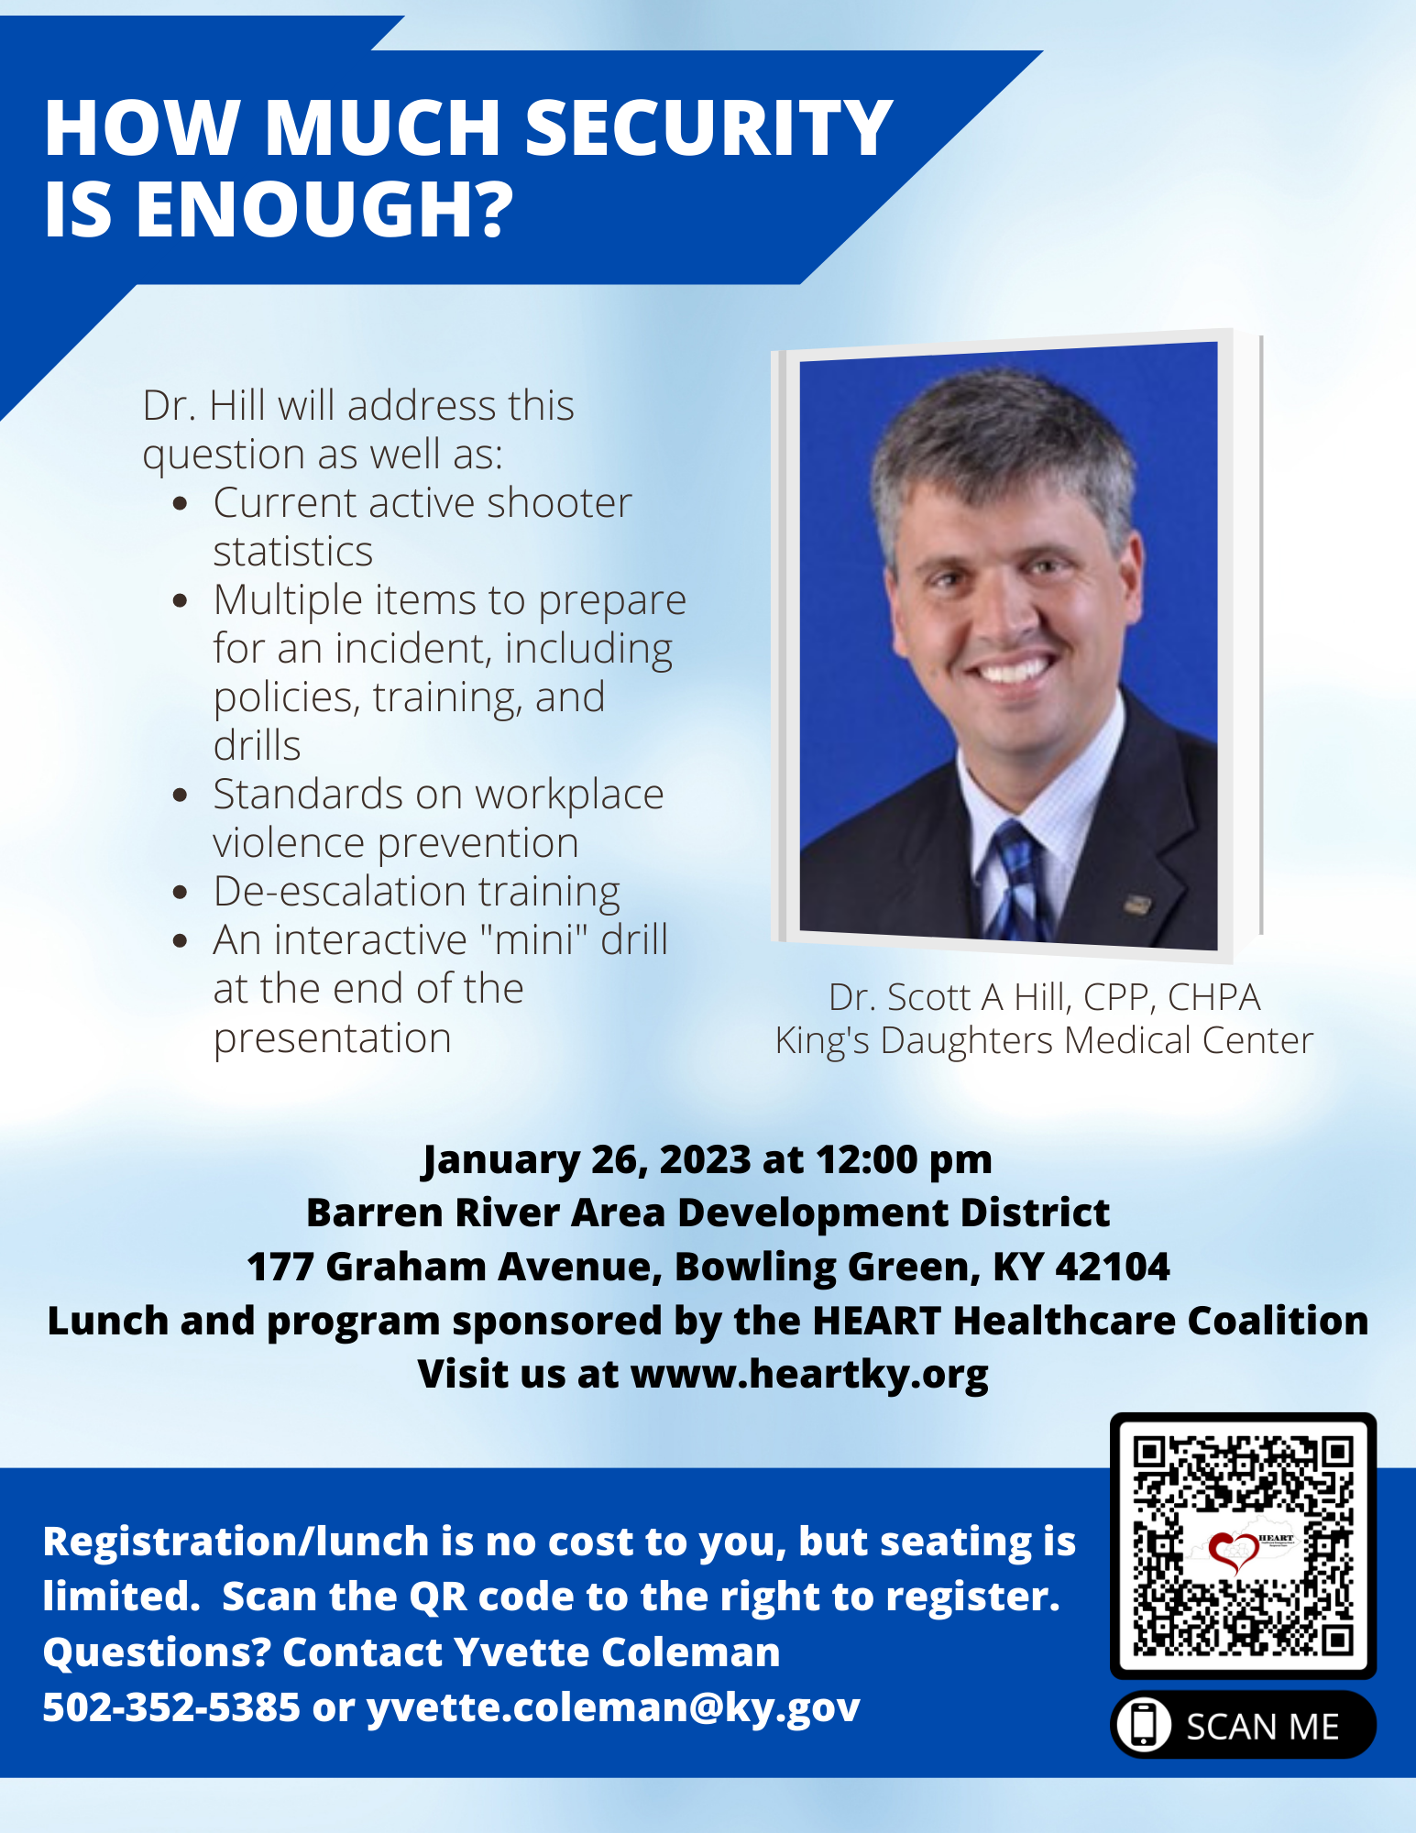
Only 38 Seats Left!
Don’t wait to register!!
11:30 am – Networking and Lunch
12:00 pm – Program Begins
1:30 pm – Question & Answer
Use this QR Code to sign in. Be sure to list ALL agencies you represent!

Slide 14
In-Person Training at BRADD
January 19-20, 2023
MGT-481 Disaster Recovery: A Strategic Overview of the Public Assistance Process
MGT-482 Disaster Recovery Public Assistance Programs, An Introduction
ThisPoto by Unknown Author is licensed under CC BY-SA-NC
2/1/23 - AWR-376 Understanding Cyber Attacks
2/2/23 – MGT-452 Physical & Cybersecurity for Critical Infrastructure
This Photo by Unknown Author is licensed under CC BY-SA

Slide 15
MGT-439 Pediatric Disaster Response and Emergency Preparedness
March 21-22, 2023
WKU Center for Research & Development
Room 129
Recommended participants:
Community and Hospital based Emergency Managers
EMS Personnel
Hospital Administration and Emergency Room Personnel
Public Safety/Public Health Personnel
School Administrators
MRC Personnel
Private Sector
Law Enforcement
Disaster Response/Relief personnel
https://my.teex.org/TeexPortal/Default.aspx?MO=mCourseCatalog&D=FP&C=MGT439&S=461

Slide 16
In-Person Training at BRADD
Infrastructure Disaster Management Certificate Program
MGT-317 (16hr) Disaster Management for Public Services – March 15-16, 2023 Register here
MGT-345 (16hr) Disaster Management for Electric Power systems – June 21-22, 2023 Register here
MGT-343 (16hr) Disaster Management for Water and Wastewater Utilities – Sept. 13-14, 2023 Register here
MGT-341 (16hr) Disaster Preparedness for Healthcare Organizations within the Community Infrastructure – December 13-14, 2023 Register here
Use this QR Code to sign in. Be sure to list ALL agencies you represent!

Slide 17
The drill was sent by TEXT and EMAIL. This exercise served as a required redundant communications drill and the RSVP for this coalition meeting.
Two components were responding YES (attending in person) or NO (not attending) or ZOOM (attending via Zoom) through BOTH text AND email.
Response from All Partners:
73.53% completed at least one portion of the drill
Response from Core* Partners:
87.5% completed at least one portion of the drill
81.25% completed both portions of the drill
January 5 Redundant Communication Drill Results
Use this QR Code to sign in. Be sure to list ALL agencies you represent!
*Core Partners are defined by the Assistant Secretary for Preparedness and Response as Hospitals, EMS, EMA, and Public Health

Slide 18
Proposed Tab to the HEART HVA
REQUIRES VOTE:
Discussion
Motion
Second
Vote – One person, One Agency

Slide 19
HEART Officer Nominations
Chairperson
Vice-Chairperson
Clinical Advisor
Lead and Co-Lead Hospital/Health Care Organization
Member at Large

Slide 20
MACH 5 - 5 Minutes to Preparedness
You have finally arrived to the EOC after being awakened at 4:00 am on Saturday morning by a very strong earthquake and you soon realize that you are the first one to the facility.
How will you ensure the EOC is properly set up to be ready for the rest of the organization when it arrives?

Slide 21
In addition to the ideas mentioned, you may also want to consider the following:
EOC Standard Operations Procedures Manual – Develop a manual that outlines the layout of the EOC, identifies the status boards/displays that should be posted and lists the communications equipment available and how it should be hooked up. Anyone should be able to use this manual to quickly set-up the EOC with little assistance.
Go Boxes – To make set-up quicker in the EOC locate all section supplies and reference documents in “Go Boxes” to facilitate the equipping of the room.
Phone Jack Labels – To make phone hook-ups fast and easy, make sure that all the phone numbers are labeled on the phone jacks at the wall.
Identify uninterruptible Power Supply Electrical Outlets – If on back-up power some power outlets may not be supported. If only some outlets are hooked up to uninterruptible Power Supply, label those outlets appropriately. In hospitals and other facilities, if you want UPS, you need to use a red socket.

Slide 22
Miscellaneous/Questions
Formation of By-Law Committee
Did you sign in? Please sign in via ReadyOp to be sure the agency/agencies you represent are included in the attendance.
Use this QR Code to sign in. Be sure to list ALL agencies you represent!

Slide 23
Next Meeting
Thursday, February 9, 2023
11:30am Lunch available/Networking
12:00pm Meeting time
Use this QR Code to sign in. Be sure to list ALL agencies you represent!

