Slide 1
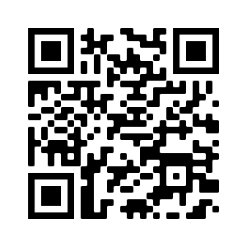
WELCOME!
Meeting SIGN-IN (Readyop)
October 12 Minutes Approval – REQUIRES VOTE
https://ky.readyop.com/fs/4osq/893976b5

Slide 2
HEART Coalition EPI Report
Notes:
** All data presented is for situational awareness and is not to be shared with the general public.

Slide 3
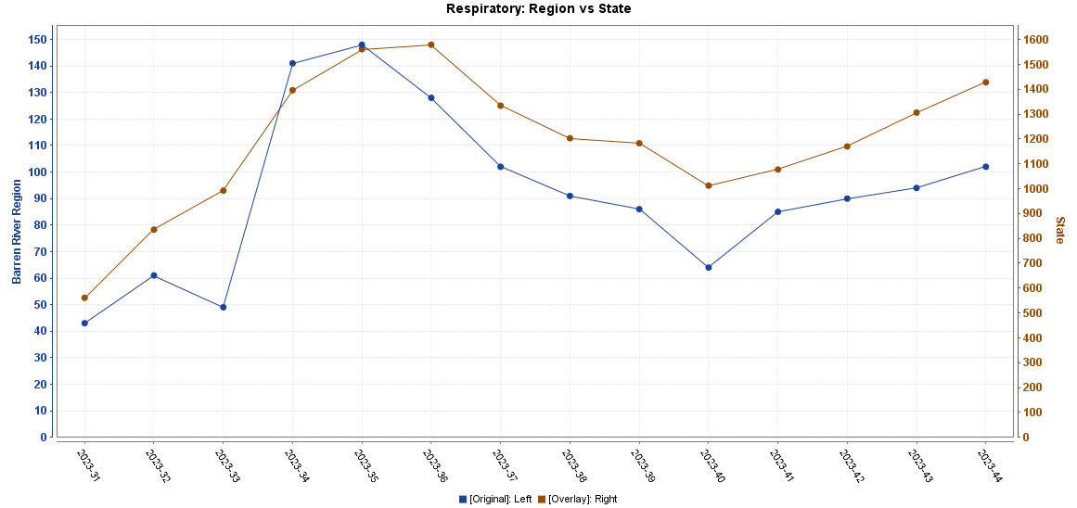
Respiratory Trends
*Data from ESSENCE: interpret with caution
Notes:
KDPH now has a respiratory dashboard you can view to see statewide trends. The graph here is showing regional data (blue, left axis) vs. state (orange?, right axis). This can not be found on the KDPH respiratory dashboard and cannot not be shared outside of this meeting.

Slide 4
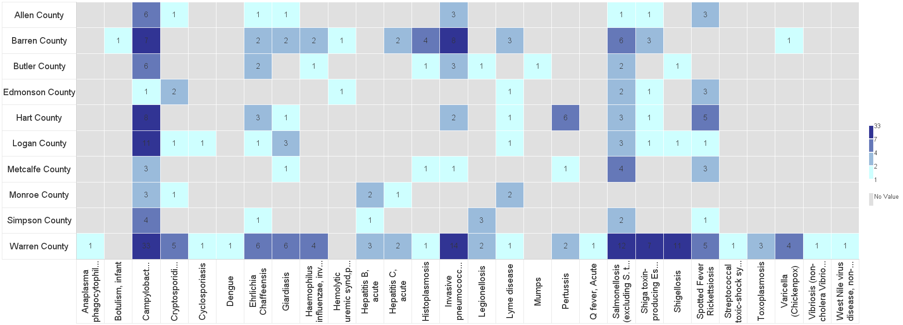
Barren River Reportable Disease 2023 Year to Date
Notes:
2023: 305 cases year-to-date, increased by 32 since last meeting.
Highest burden: Campy (82), Salmonella (35), IPD (31). Enteric diseases are the highest burden followed by tickborne diseases on this table.
**Numbers are not finalized and are subject to change.

Slide 5
Contact
Regional Epi: Kristen Eggles
Kristen.Eggles@ky.gov
Ext. 262
District Epi: India Martinez
India.Martinez@barrenriverhealth.org
Ext. 105

Slide 6
RTTDC/Burn REGISTRATION OPEN NOW
Rural Trauma Team Development Course/Burn Course (U of L)
January 25, 2024, 8am – 5pm
Medical Education Complex Building 339 US 31W Bypass, Bowling Green (Room # TBD)
Register early! We need to order books and want everyone to have a book available.

Slide 7
ICS 300 and ICS 400
SAVE THE DATES!
ICS 300 – Intermediate ICS for Expanding Incidents
February 6, 13, 20
WKU Innovation Campus @
1324 Campbell Lane, Bowling Green
ICS 400 – Advanced ICS
February 28, 29
WKU Innovation Campus @
1324 Campbell Lane, Bowling Green

Slide 8
Budget Update
Initial HPP Funding, Region 4 $37,500
Carryover 17,341
Total Funding FY 23-24 $54,841
Budgeted Expenses (Rounded) $44,260
Balance not Budgeted $10,581
Deadline for submitting your interest in Region 4 Savannah Conference – Dec. 29 (Allocated $4,200)
A/C unit for Hospital Tent

Slide 9
Subcommittee Reports
Long Term Care – Greg Manley
Communications: Robert Doughty
Medical Reserve Corp (MRC) – Carolyn Bishop
Training & Exercise – Yvette Coleman

Slide 10
Important Dates!
November 15: Winter Weather Hazards: Science and Preparedness
November 15: LTC Education Day 2023 (Madisonville)
December 13-14: Disaster Preparedness for Healthcare Organizations within Community Infrastructure
Save the Date: Jan 11- This is a T.E.S.T Radiation Simulation TTX during Coalition meeting
January 25 – Rural Trauma Team Development Course/Burn
March 19-20: Medical Management of CBRNE Events
April 2-3: Emergency Operations Center: Operations and Planning for All-Hazards Events

Slide 11
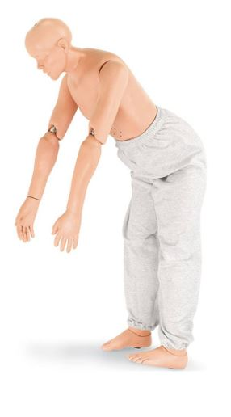
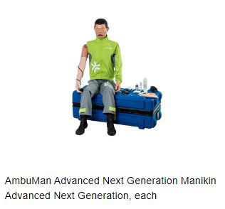
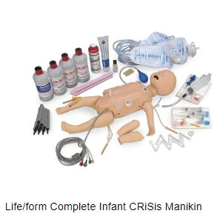
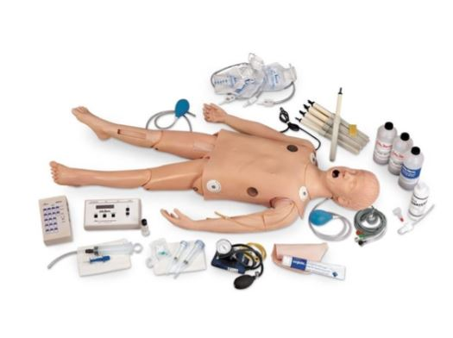
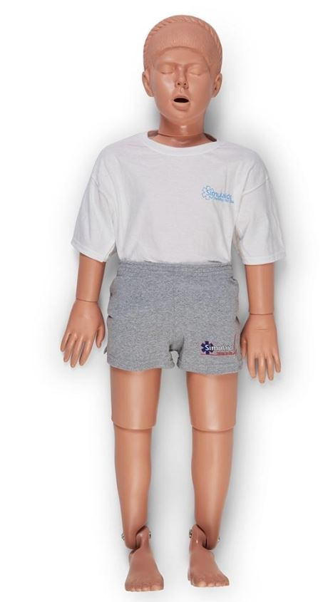
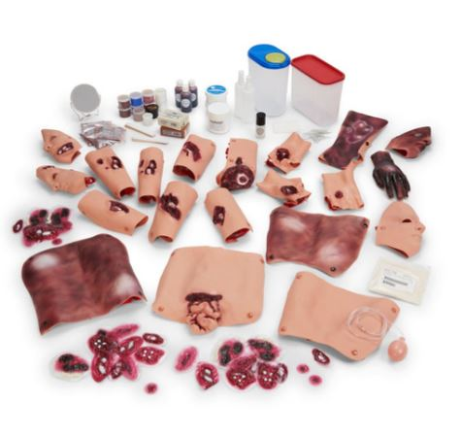
Training Resources for Active Coalition members
3 ea. Flexible Rescue Randy 5’5”
6 ea. Rescue Randy, 5’5” 145#
Trauma Moulage Kit & EMT Casualty Simulation Kit
3 ea. Rescue Jennifer, 7-12 y/o, 38#
LifeForm Deluxe Child ChriSis Manikin

Slide 12
GUEST Speaker
Vickie Siedel, MLT (ASCP)
Readiness & Response Coordinator
West Kentucky Healthcare Coalition
Mayfield, KY
Vickie.Siedel@ky.gov
KO4ASI
CM

Slide 13
Information Sharing/Unmet Needs
Swatting – Schools in Kentucky (Louisville and Lexington), Ohio (Cincinnati), and Indiana (Evansville) receiving fake reports of active aggressors on campus. Swatting is a term used for calls to 911 about fake emergencies. (More information in the KHREF Emergency Preparedness Update Nov 8)

Slide 14
NEXT MEETING
Thursday, December 7, 2023
11:30am Networking Lunch
12:00pm HCC Meeting time
Use this QR Code to sign in. Be sure to list ALL agencies you represent!

