Slide 1
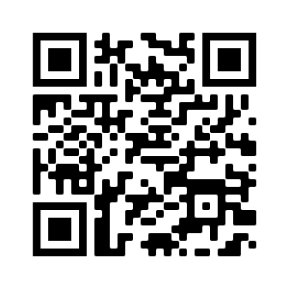
WELCOME!
For attendance credit, sign in with QR Code or link beside the QR Code
https://ky.readyop.com/fs/4osq/893976b5

Slide 2
MINUTES APPROVAL for
August 10, 2023 Meeting
REQUIRES VOTE
Discussion/Corrections? - Motion – Second
Minutes
Agency/Your name
Yes/No or With Revisions

Slide 3
HEART Coalition EPI Report
Notes:
** All data presented is for situational awareness and is not to be shared with the general public.

Slide 4
Region 4 COVID-19 Numbers
County | Cases | Deaths
Allen | 8,965 | 128
Barren | 18,329 | 259
Butler | 4,940 | 63
Edmonson | 3,447 | 61
Hart | 7,205 | 112
Logan | 10,834 | 148
Metcalfe | 3,979 | 81
Monroe | 4,698 | 94
Simpson | 8,002 | 113
Warren | 58,264 | 454
Total: | 128,663 | 1,513
Notes:
This data is from KDPH COVID dashboard.
**This table and numbers below are showing COVID deaths as they are being counted instead of when they occurred.
August to September
+ 2885 cases
+ 7 deaths
July to August
+ 703 cases
+ 9 deaths
June to July
+ 666 cases
+ 18 deaths
May to June
+377 cases
+15 deaths
April to May
+815 case
+17 deaths
March to April
+984 case
+34 deaths
February to March
+1,720 cases
+8 deaths
January to February
+2,487 cases
+21 deaths
December to January:
+ 3,281 cases
+ 18 deaths
November to December:
+2,011 cases
+ 13 deaths

Slide 5
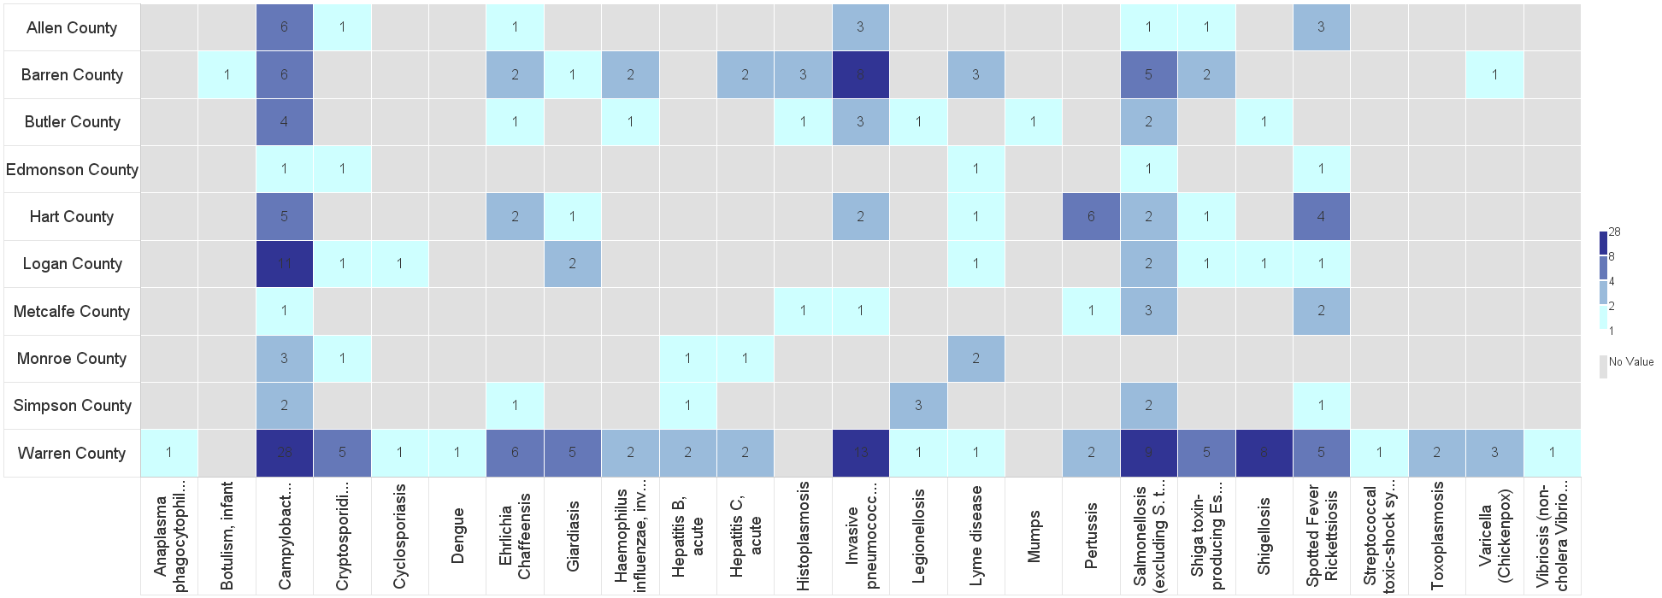
Barren River Reportable Disease 2023 Year to Date
Notes:
2023: 248 cases year-to-date
Highest burden: Campy (65), IPD (30), and Salmonella (27). Enteric diseases are the highest burden followed by tickborne diseases.
**Numbers are not finalized and are subject to change.

Slide 6
Contact
Regional Epi: Kristen Eggles
Kristen.Eggles@ky.gov
Ext. 262
District Epi: India Martinez
India.Martinez@barrenriverhealth.org
Ext. 105

Slide 7
Service Animal Etiquette
Maria Church, ADA Coordinator
July 12, 2023

Slide 8
Subcommittee Reports
Budget/Finance Update
Received:
This is a TEST Radiation TTX Simulation Game
Anticipated Date of Receipt:
Toner (for back up) – Sept 20
EvacuB – Sept 22
WiFi Case – Sept 29

Slide 9
Subcommittee Reports
Long Term Care – Greg Manley
Communications: Report on Hart County Communications Exercise – Charlie O’Neal
Medical Reserve Corp (MRC) – Carolyn Bishop
Training & Exercise -

Slide 10
Important Training Dates!
October 3-4: MGT 318 POD Course
October 24: Senior Officials All Hazards Workshop
November 1: Community Planning for Disaster Recovery
November 15: Winter Weather Hazards: Science and Preparedness
November 15: LTC Education Day 2023 (Madisonville)
December 13-14: Disaster Preparedness for Healthcare Organizations within Community Infrastructure
Save the Date: January 25 – Rural Trauma Team Development Course/Burn
March 19-20: Medical Management of CBRNE Events

Slide 11
MEDICAL TRANSPORTATION SUPPORT
By County

Slide 12
Comments/Unmet Needs

Slide 13
Next Meeting
Thursday, October 12, 2023
11:30am Lunch available/Networking
12:00pm Meeting time
Use this QR Code to sign in. Be sure to list ALL agencies you represent!

