Slide 1
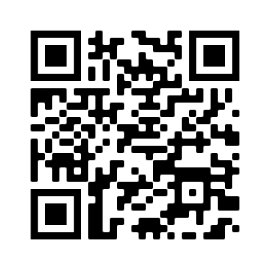
WELCOME!
For attendance credit, sign in with QR Code or link beside the QR Code
https://ky.readyop.com/fs/4osq/893976b5

Slide 2
MINUTES APPROVAL for
June 8, 2023 Meeting
REQUIRES VOTE
Discussion/Corrections? - Motion – Second
Zoom Voters: Put the following in the chat
Minutes
Agency/Your name
Yes/No or With Revisions

Slide 3
HEART Coalition EPI Report
Notes:
** All data presented is for situational awareness and is not to be shared with the general public.

Slide 4
Region 4 COVID-19 Numbers
County | Cases | Deaths
Allen | 8,694 | 127
Barren | 17,832 | 258
Butler | 4,859 | 62
Edmonson | 3,377 | 61
Hart | 7,083 | 112
Logan | 10,596 | 145
Metcalfe | 3,832 | 81
Monroe | 4,580 | 94
Simpson | 7,737 | 113
Warren | 56,485 | 444
Total: | 125,075 | 1,497
Notes:
This data is from KDPH COVID dashboard.
**This table and numbers below are showing COVID deaths as they are being counted instead of when they occurred.
June to July
+ 666 cases
+ 18 deaths
May to June
+377 cases
+15 deaths
April to May
+815 case
+17 deaths
March to April
+984 case
+34 deaths
February to March
+1,720 cases
+8 deaths
January to February
+2,487 cases
+21 deaths
December to January:
+ 3,281 cases
+ 18 deaths
November to December:
+2,011 cases
+ 13 deaths

Slide 5
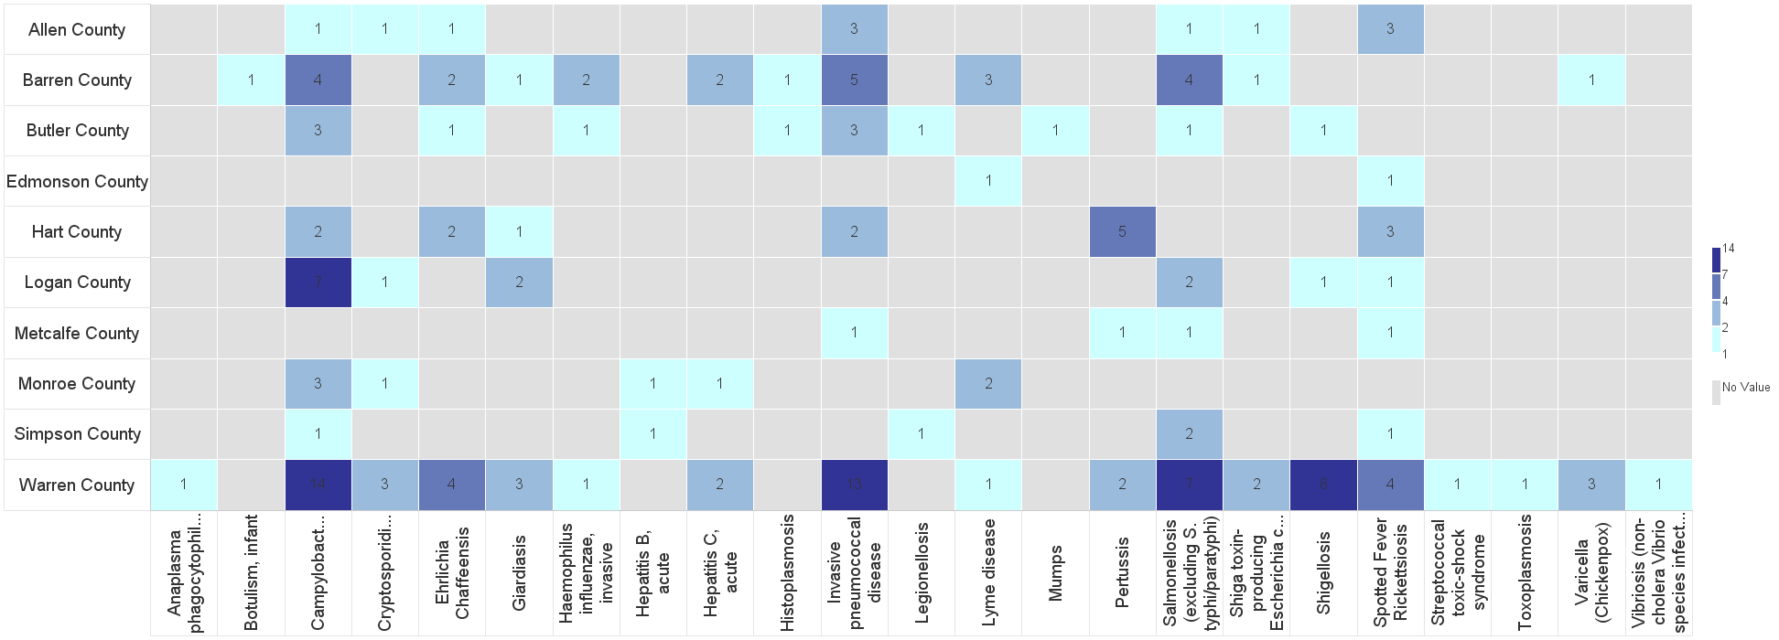
Barren River Reportable Disease 2023 Year to Date
Notes:
2023: 171 cases confirmed/probable/suspect as of 7/12/2023. This time last year, there were about 157 cases investigated.
Highest burden: Campy (35), IPD (27), and Salmonella (18). Enteric diseases are the highest burden followed by tickborne diseases.
**Numbers are not finalized and are subject to change.

Slide 6
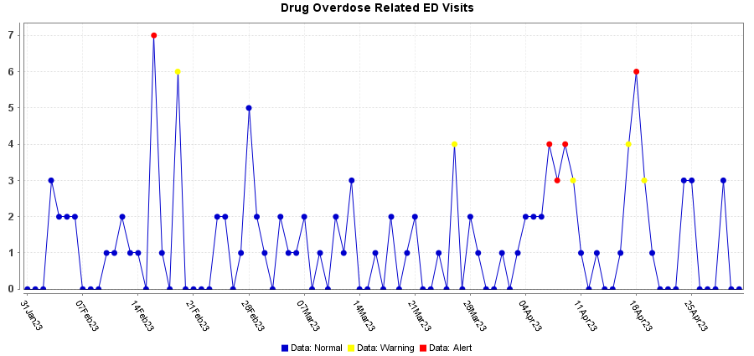
Syndromic Data: ED Visits for Overdose
Notes:
Overdose Related ED Visits: Fentanyl, Heroin, Opioid, Benzodiazepine, and Cocaine
* These are patients who were seen at hospitals in the Barren River Region. Bases on Chief Complaint and Discharge Diagnosis coding.

Slide 7
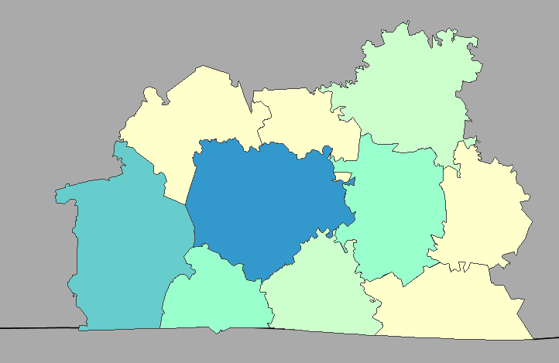
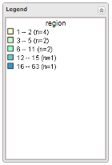
Syndromic Data: ED Visits for Overdose
Notes:
Breakdown by patient county.

Slide 8
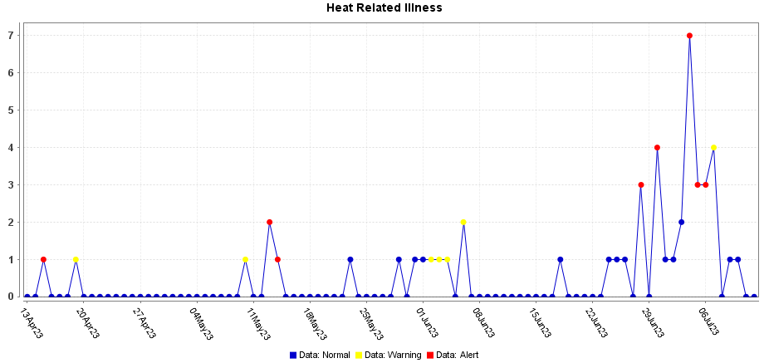
Syndromic Data: ED Visits for Heat Related Injuries
Notes:
July 4th had the highest (7) ED visits related in Heat Related Illness.

Slide 9
Contact
Regional Epi: Kristen Eggles
Kristen.Eggles@ky.gov
Ext. 262
District Epi: India Martinez
India.Martinez@barrenriverhealth.org
Ext. 105

Slide 10
Michael Webster Bowling Green Fire Department HAZMAT Team Response Capabilities for the HEART Region

Slide 11
Miscellaneous/Questions
Overdoses from marijuana edibles rise in children report: https://www.cbsnews.com/news/weed-edibles-kid-friendly-packaging-doritos/
Unmet Needs? Identified Gaps?
Use this QR Code to sign in. Be sure to list ALL agencies you represent!

Slide 12
Important dates!
September 14 meeting is Zoom ONLY
October 24 Senior Officials All Hazards Workshop
December 7 Meeting – 1st Thursday of month
December 13-14 Disaster Preparedness for Healthcare Organizations within Community Infrastructure

Slide 13
Next Meeting
Thursday, August 10, 2023
11:30am Lunch available/Networking
12:00pm Meeting time
Use this QR Code to sign in. Be sure to list ALL agencies you represent!

