Slide 1
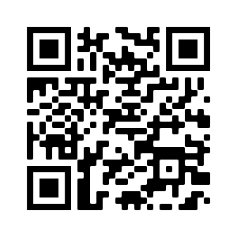
PLEASE SIGN IN WITH QR CODE

Slide 2
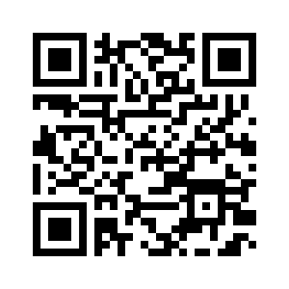
WELCOME!
MINUTES APPROVAL for
February 9, 2023 Meeting
REQUIRES VOTE
Discussion/Corrections? - Motion – Second
Vote – You MUST list the agency you are voting for! You may represent more than one agency for attendance, but ONLY vote as a representative for ONE agency.
Use this QR Code to vote. Be sure to vote your primary agency ONLY!

Slide 3
HEART Coalition EPI Report
Notes:
** All data presented is for situational awareness and is not to be shared with the general public.

Slide 4
Region 4 COVID-19 Numbers
County | Cases | Deaths
Allen | 8,543 | 125
Barren | 17,377 | 239
Butler | 4,769 | 58
Edmonson | 3,299 | 57
Hart | 6,908 | 110
Logan | 10,360 | 140
Metcalfe | 3,739 | 77
Monroe | 4,508 | 90
Simpson | 7,547 | 104
Warren | 55,374 | 428
Total: | 122,424 | 1,428
Notes:
This data is from KDPH COVID dashboard.
February to March
+1,720 cases
+8 deaths
January to February
+2,487 cases
+21 deaths
December to January:
+ 3,281 cases
+ 18 deaths
November to December:
+2,011 cases
+ 13 deaths

Slide 5
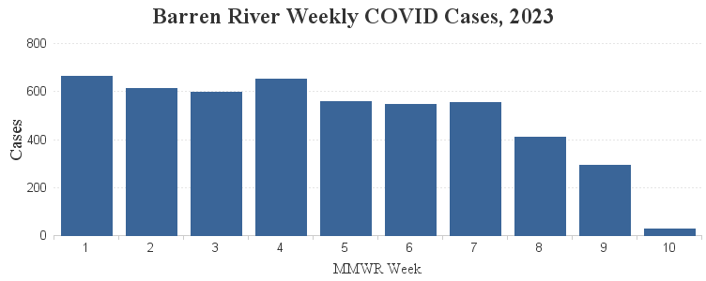
2023 Weekly COVID-19 Cases

Slide 6
Influenza
Notes:
**2020-2021 data may not be representative of true numbers of cases due to COVID-19.
MMWR week 51, flu types shifted to flu B. Although MMWR week 5 only had 8 cases, 6 of them were flu B.
There are been 11 flu related deaths in the Region. 1 more death is pending review.

Slide 7
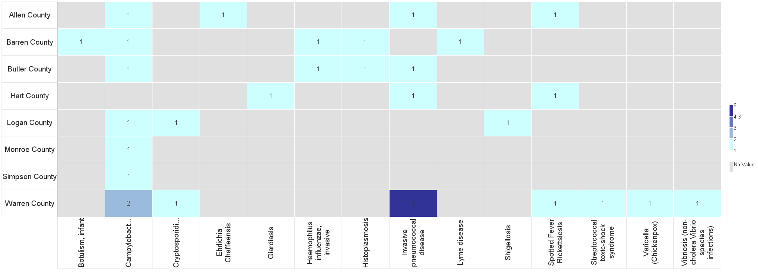
Barren River Reportable Disease 2023 Year to Date
Notes:
2022: 344 Reportable Diseases, investigations are still under review.
2023: 14 Reportable Diseases
**Numbers are not finalized and are subject to change.

Slide 8
Contact
Regional Epi: Kristen Eggles
Kristen.Eggles@ky.gov
Ext. 262
District Epi: India Martinez
India.Martinez@barrenriverhealth.org
Ext. 105

Slide 9
COMMITTEE UPDATES
Long Term Care
Communications
Training & Exercise
Budget Update – FY22-23
Use this QR Code to sign in. Be sure to list ALL agencies you represent!

Slide 10
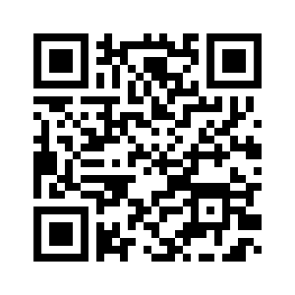
Budget FY22-23
#1. Training/Exercise meals and supplies – This is to cover expenses for food/materials for training and exercises – High estimate $1500 for all
#2. HCC Brother Printer – Current printer is HP Envy Photo. $400-$700 price range.
*There will be additional items that we will need to vote on by email due to not meeting in April.

Slide 11
Infectious Disease Communication/Testing Gap
Issue:
Some LTC Residents discharged from the hospital have returned to facilities with early signs of COVID-19 or other infectious disease
Residents are tested once they arrive at LTC facility and found to be positive for COVID
Residents have potentially exposed other residents
Solution:
KHA small groups/work groups to promote practice of testing residents prior to discharge to LTC
Communicate results with LTC facilities prior to residents
LTC facilities can isolate positive residents

Slide 12
Measles public call center
Call Center Hours 8am-4:30pm
855-598-2246
Healthcare Provider Resources can be found at https://www.chfs.ky.gov/agencies/dph/dehp/idb/Pages/measles.aspx
KDPH Measles Testing Guidance
https://www.chfs.ky.gov/agencies/dph/dehp/idb/Documents/KDPHMeaslesTestingGuidance.pdf

Slide 13
Meeting Changes!
NO meeting in April
September 14 meeting is Zoom ONLY

Slide 14
By-Laws Workgroup
Tony Keithley – Hart Co. EMA
Joyce Noe – Logan Memorial Hospital
Garland Gilliam – Barren Co. EMA
Karen Wilson – Greenview Surgery Center
Amanda Allen – Glasgow State
Keith Sanders – Edmonson EMS

Slide 15
Reminder!
What? Executive Breakfast
Who? Member and Prospective Member Executives and Elected Officials
When? May 3, 9am-11am
Where? Barren River Area Development District

Slide 16
MACH 5 - 5 Minutes to Preparedness
On your way to the EOC/DOC you passed many residences and businesses that were obviously damaged by the earthquake. You saw people standing around outside of their homes and buildings. You arrived at the EOC/DOC and set it up. No one else has yet arrived.
You are alone in the EOC/DOC. What should you do now?
Keep responses to 25 to 30 seconds.

Slide 17
In addition to the ideas mentioned, you may also want to consider the following:
Tune to EAS – Every EOC/DOC needs to have access to a battery operated radio. Immediately tune to your areas EAS stations. These stations have back-up generators and should be on the air.
Check in with Dispatch – If any phones are working, Dispatch would be able to fill you inon the types of calls coming in.
Access the Internet – If the internet is functioning, you may be able to get all of the information you need. Make sure that you hae bookmarked all of the sites that would provide pertinent information during a disaster. Visit the State’s Response Information Management System, or the County’s website to see if anything has been posted.
Radio Amateur Civil Emergency Services Radio (RACES) Base Station – Does your EOC/DOC have a RACES base station? If so, turn it on and monitor the information . The RACES members should be starting a communications net.
Satellite Capabilities – Has your jurisdiction recently purchased a satellite phone? Who else has the satellite phones in the area that you could communicate with to gather information If possible, set up a satellite phone group callout before a disaster.

Slide 18
Miscellaneous/Questions
Public Health Emergency (PHE) for COVID-19 will end on May 11, 2023
Provider specific fact sheets can be found at https://www.cms.gov/coronavirus-waivers
Unmet Needs?
Did you sign in? Please sign in via ReadyOp to be sure the agency/agencies you represent are included in the attendance.
Use this QR Code to sign in. Be sure to list ALL agencies you represent!

Slide 19
The drill was sent by TEXT and EMAIL. This exercise served as a required redundant communications drill and the RSVP for this coalition meeting.
Two components were responding YES (attending in person) or NO (not attending) or ZOOM (attending via Zoom) through BOTH text AND email.
Response from All Partners:
80.88% completed at least one portion of the drill
Response from Core* Partners:
93.75% completed at least one portion of the drill
90.6% completed both portions of the drill
March 6 Redundant Communication Drill Results
Use this QR Code to sign in. Be sure to list ALL agencies you represent!
*Core Partners are defined by the Assistant Secretary for Preparedness and Response as Hospitals, EMS, EMA, and Public Health

Slide 20
MGT-439 Pediatric Disaster Response and Emergency Preparedness
March 21-22, 2023
WKU Center for Research & Development
Room 129
Recommended participants:
Community and Hospital based Emergency Managers
EMS Personnel
Hospital Administration and Emergency Room Personnel
Public Safety/Public Health Personnel
School Administrators
MRC Personnel
Private Sector
Law Enforcement
Disaster Response/Relief personnel
https://my.teex.org/TeexPortal/Default.aspx?MO=mCourseCatalog&D=FP&C=MGT439&S=461

Slide 21
In-Person Training at BRADD
Infrastructure Disaster Management Certificate Program
MGT-317 (16hr) Disaster Management for Public Services – March 15-16, 2023 Register here
MGT-345 (16hr) Disaster Management for Electric Power systems – June 21-22, 2023 Register here
MGT-343 (16hr) Disaster Management for Water and Wastewater Utilities – Sept. 13-14, 2023 Register here
MGT-341 (16hr) Disaster Preparedness for Healthcare Organizations within the Community Infrastructure – December 13-14, 2023 Register here
Use this QR Code to sign in. Be sure to list ALL agencies you represent!

Slide 22
Next Meeting
Thursday, May 11, 2023
11:30am Lunch available/Networking
12:00pm Meeting time
Use this QR Code to sign in. Be sure to list ALL agencies you represent!

